Slide 1

Tabletop Game Counter
By Ankitraj jha, Sejal Singh, Parthiv kumar, Sairaj Jadhav

Slide 2
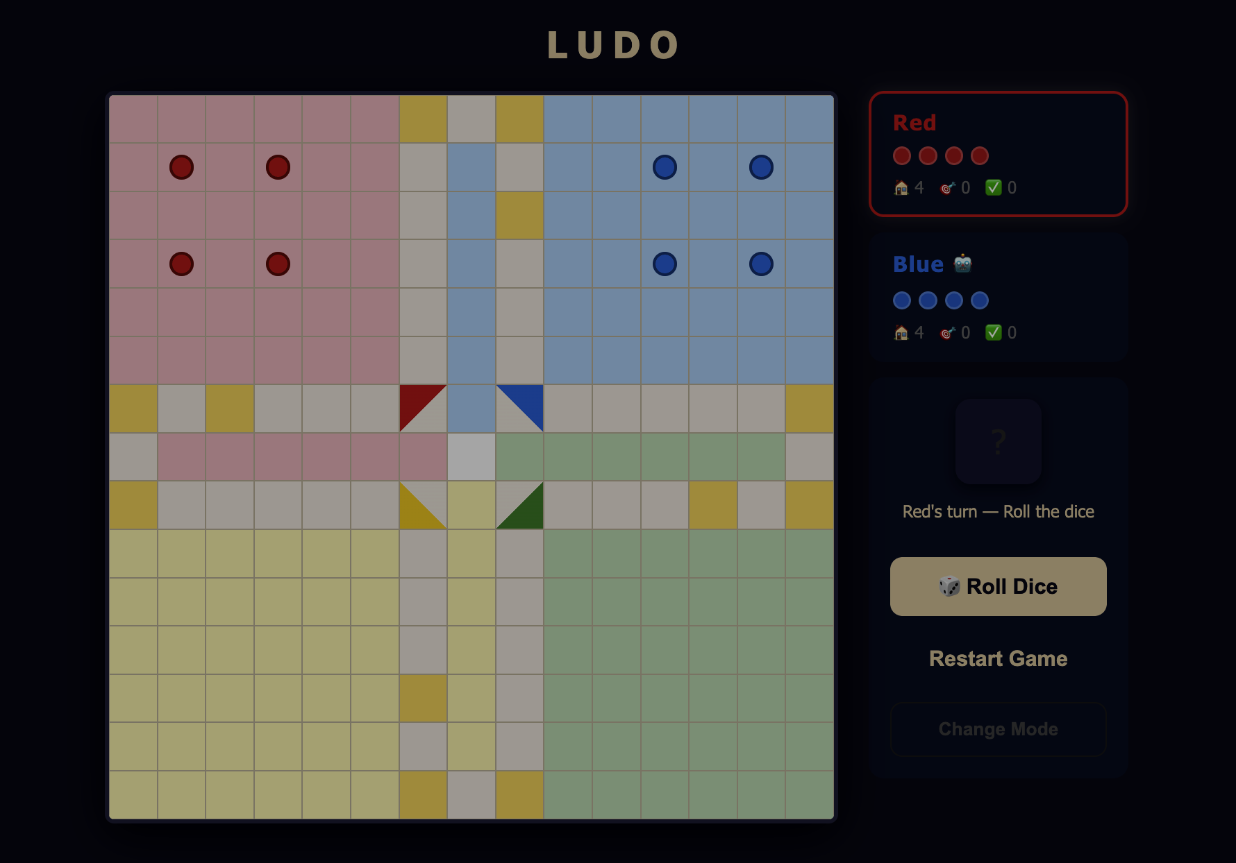
Tabletop Game Counter
Idea:
Extended the basic tabletop game counter into a complete Ludo game
Outcome:
Fully working Ludo game
Interactive gameplay experience
Applied game logic & UI design
Features:
Multiple modes (2 players, 4 players, vs AI) 🤖
Dice roll system 🎲
Turn-based gameplay
Token movement based on dice
Connection to Problem Statement:
Counter (+1) → token moves forward
Score → tokens reaching home ✅
Reset → restart game 🔄

Slide 3
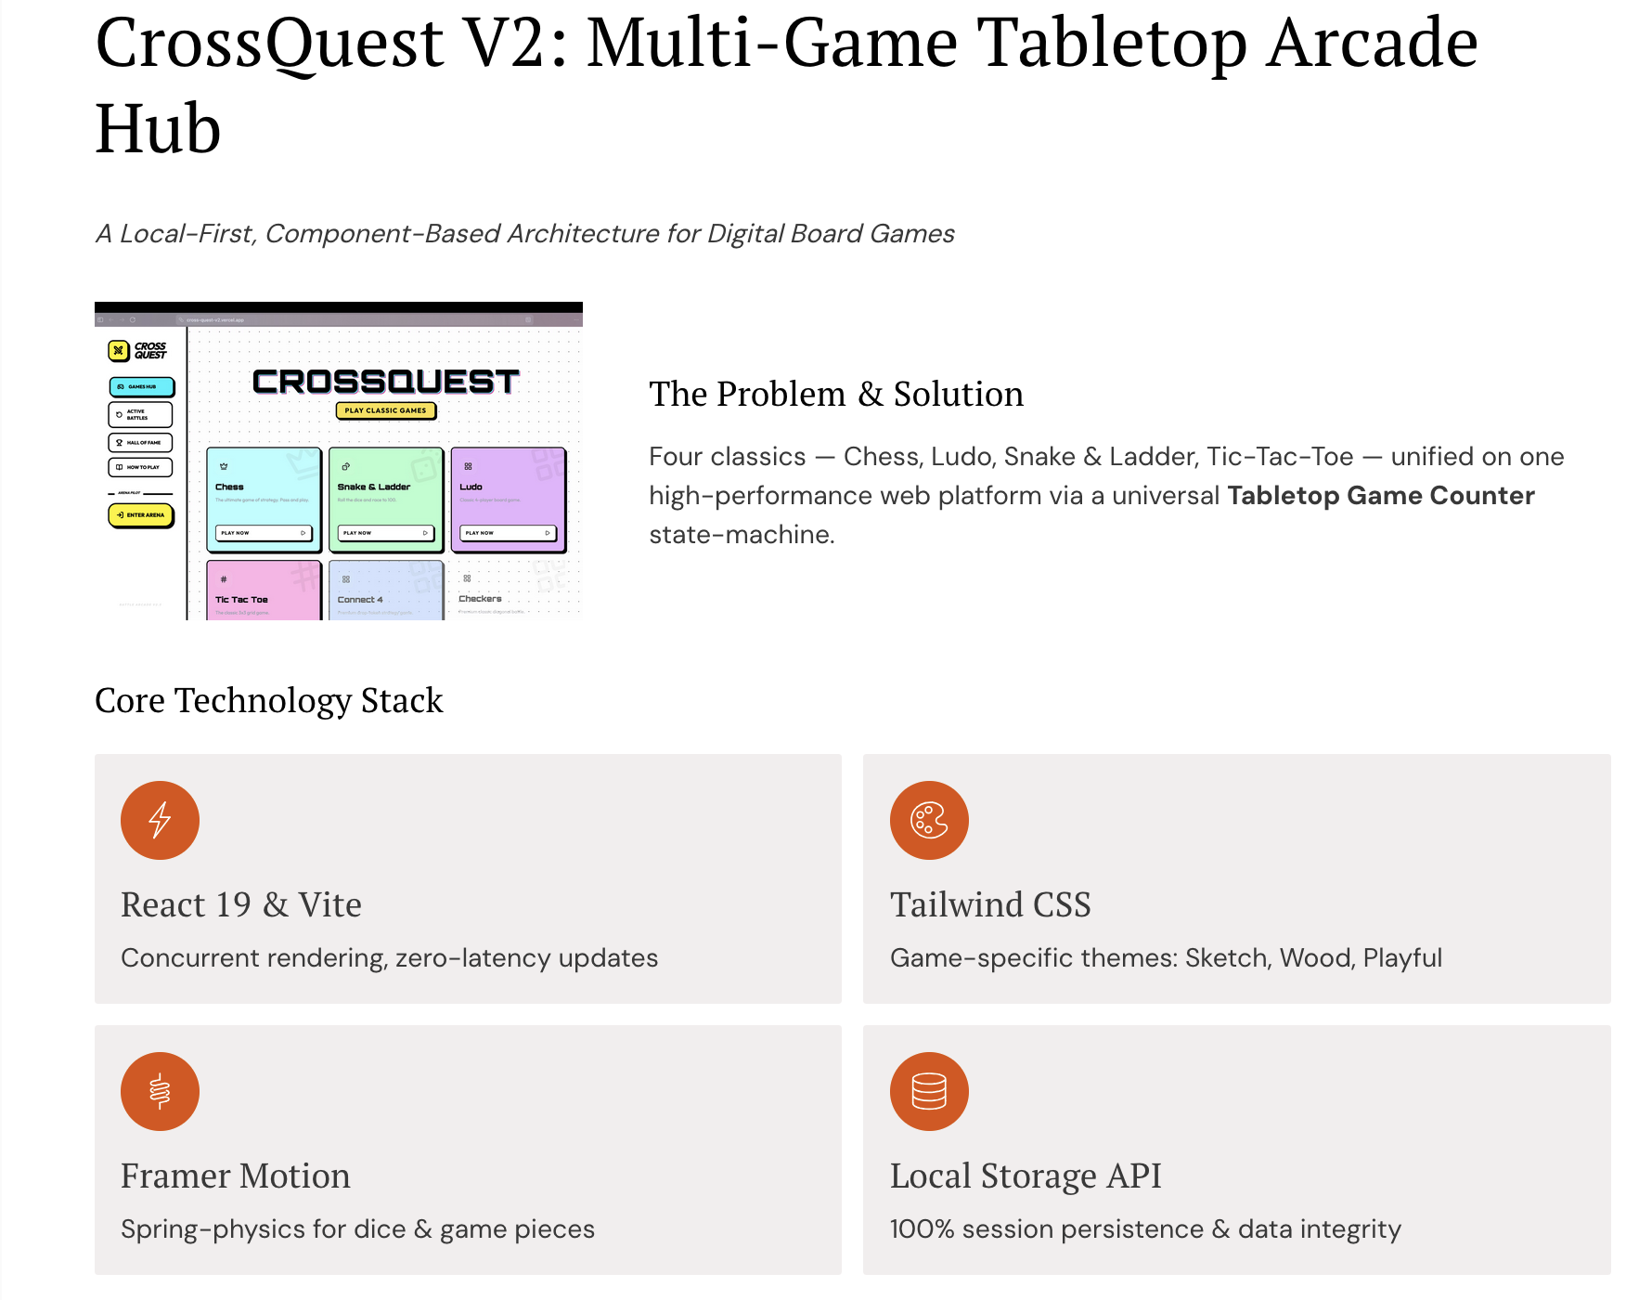

Slide 4
Thank You

